Slide 1
Predicting Deer Age via Computer Vision
9/25/2025

Slide 2
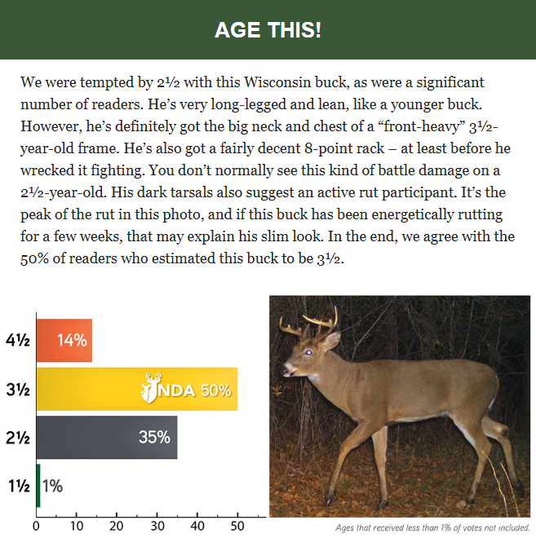
Data Collection
Data derived from NDA’s weekly newsletter
NDA’s decision used as “correct” answer
Notes:
In addition to other resources (ex. Youtube, Facebook, etc.), the National Deer Association’s “Age This!” surveys provide much of the initial data.
Each week, results from the previous week’s survey provide two items:
An aged deer photo with explanation of why the decision was made
Statistics on how others voted for the previous week’s survey.
The former provides images, its metadata stored within the filename for each image.
The latter provides statistics for human prediction accuracy, also collected for each image.

Slide 3
Data Collection
Human accuracy derived from survey results
Notes:
In addition to other resources (ex. Youtube, Facebook, etc.), the National Deer Association’s “Age This!” surveys provide much of the initial data.
Each week, results from the previous week’s survey provide two items:
An aged deer photo with explanation of why the decision was made
Statistics on how others voted for the previous week’s survey.
The former provides images, its metadata stored within the filename for each image.
The latter provides statistics for human prediction accuracy, also collected for each image.

Slide 4
Data Collection
250116_241016_VA_2p5_NDA
Survey images used to build dataset
Date, time, location preserved in filename
Notes:
In addition to other resources (ex. Youtube, Facebook, etc.), the National Deer Association’s “Age This!” surveys provide much of the initial data.
Each week, results from the previous week’s survey provide two items:
An aged deer photo with explanation of why the decision was made
Statistics on how others voted for the previous week’s survey.
The former provides images, its metadata stored within the filename for each image.
The latter provides statistics for human prediction accuracy, also collected for each image.

Slide 5
Data Collection
Descriptions provide data for further analysis
(ex. Vision language models)
Notes:
In addition to other resources (ex. Youtube, Facebook, etc.), the National Deer Association’s “Age This!” surveys provide much of the initial data.
Each week, results from the previous week’s survey provide two items:
An aged deer photo with explanation of why the decision was made
Statistics on how others voted for the previous week’s survey.
The former provides images, its metadata stored within the filename for each image.
The latter provides statistics for human prediction accuracy, also collected for each image.

Slide 6
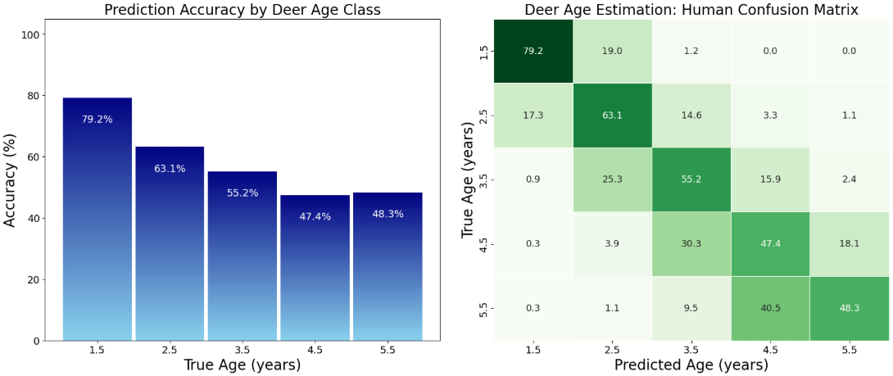
Human Accuracy
100
80
79.2%
60
63.1%
55.2%
47.4%
48.3%
40
20
0
1.5
2.5
3.5
4.5
5.5+
Prediction accuracy peaks with 1.5 y.o. bucks
Lowest accuracy occurs with 4.5, 5.5+ yrs
Notes:
In addition to other resources (ex. Youtube, Facebook, etc.), the National Deer Association’s “Age This!” surveys provide much of the initial data.
Each week, results from the previous week’s survey provide two items:
An aged deer photo with explanation of why the decision was made
Statistics on how others voted for the previous week’s survey.
The former provides images, its metadata stored within the filename for each image.
The latter provides statistics for human prediction accuracy, also collected for each image.

Slide 7
Human Accuracy
79.2%
19.0%
1.2%
0.0%
0.0%
17.3%
63.1%
14.6%
3.3%
1.1%
0.9%
25.3%
55.2%
15.9%
2.4%
0.3%
3.9%
30.3%
47.4%
18.1%
0.3%
1.1%
9.5%
40.5%
48.3%
For 2.5-4.5, people tend to guess younger
For 5.5+, nearly half the guesses are 1 year off
Notes:
In addition to other resources (ex. Youtube, Facebook, etc.), the National Deer Association’s “Age This!” surveys provide much of the initial data.
Each week, results from the previous week’s survey provide two items:
An aged deer photo with explanation of why the decision was made
Statistics on how others voted for the previous week’s survey.
The former provides images, its metadata stored within the filename for each image.
The latter provides statistics for human prediction accuracy, also collected for each image.

Slide 8
Human Accuracy
100
79.2%
19.0%
1.2%
0.0%
0.0%
80
79.2%
17.3%
63.1%
14.6%
3.3%
1.1%
60
63.1%
55.2%
0.9%
25.3%
55.2%
15.9%
2.4%
40
47.4%
48.3%
0.3%
3.9%
30.3%
47.4%
18.1%
20
0.3%
1.1%
9.5%
40.5%
48.3%
0
1.5
2.5
3.5
4.5
5.5+
Random guessing | 20.00%
Avg. human accuracy | 58.64%
Majority vote accuracy | 74.47%
Within 1 year accuracy | 95.18%
Average human accuracy is ~60%, but the accuracy needed for research is 80%.
Notes:
In addition to other resources (ex. Youtube, Facebook, etc.), the National Deer Association’s “Age This!” surveys provide much of the initial data.
Each week, results from the previous week’s survey provide two items:
An aged deer photo with explanation of why the decision was made
Statistics on how others voted for the previous week’s survey.
The former provides images, its metadata stored within the filename for each image.
The latter provides statistics for human prediction accuracy, also collected for each image.

Slide 9
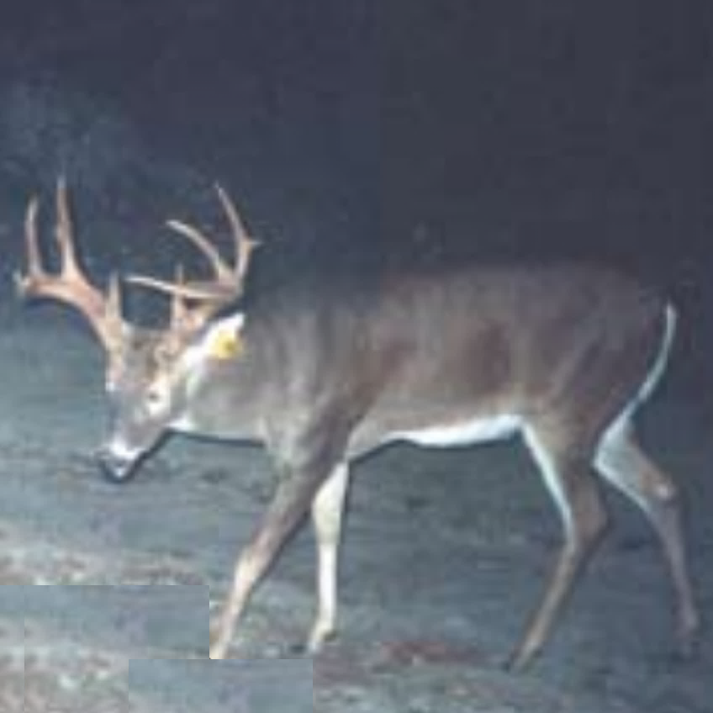
Data Standardization
Data collected through various sources
Resized images stored; info stored in metadata
Python collects, interpolates images
ML models expect squared input (ex. ResNet expects 224x224)
Similarly, images in the dataset are cropped to a square
The crop aims to include as much of the deer as possible
Only body contours matter in the crop; antlers / background are not considered
Model development
Store weights for inference
Data input by user via website
Data transferred to model via Railway
Predictions returned to user via website
250116_241016_VA_2p5_NDA.png
Notes:
We know a priori that computer vision models like ResNet expect square images of 224x224 resolution.
Therefore, initial images are captured, cropped, and formatted to fit the 1:1 aspect ratio requirements.
Cropping is done with respect to the deer’s body, not the antlers or background
This forces the model to only consider body composition, dimensions, and pose rather than antler size or location.

Slide 10
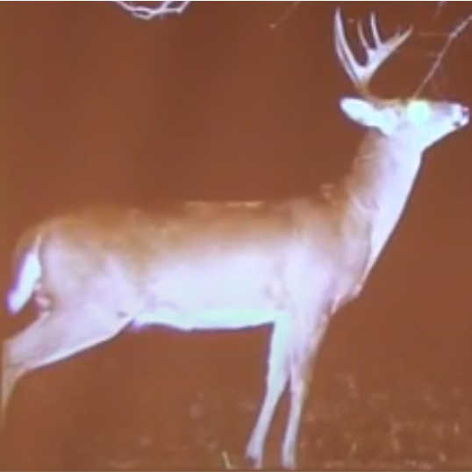
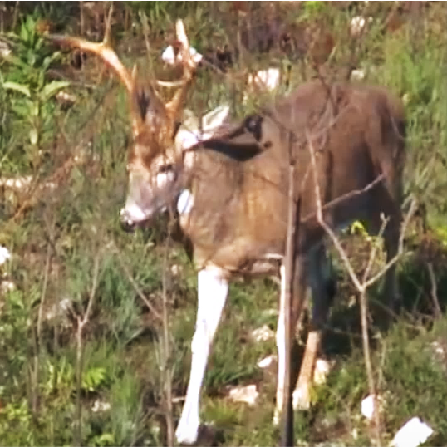
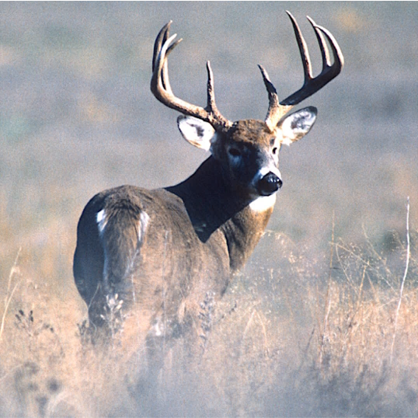
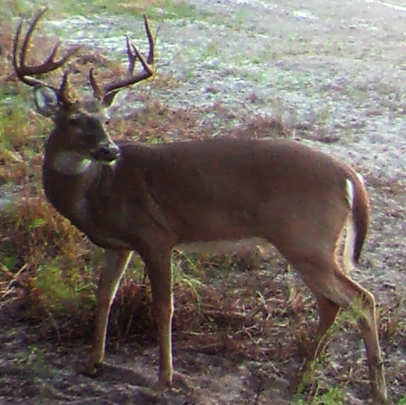
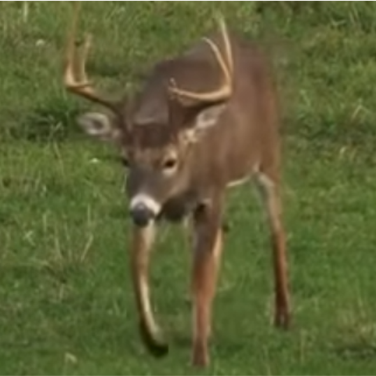
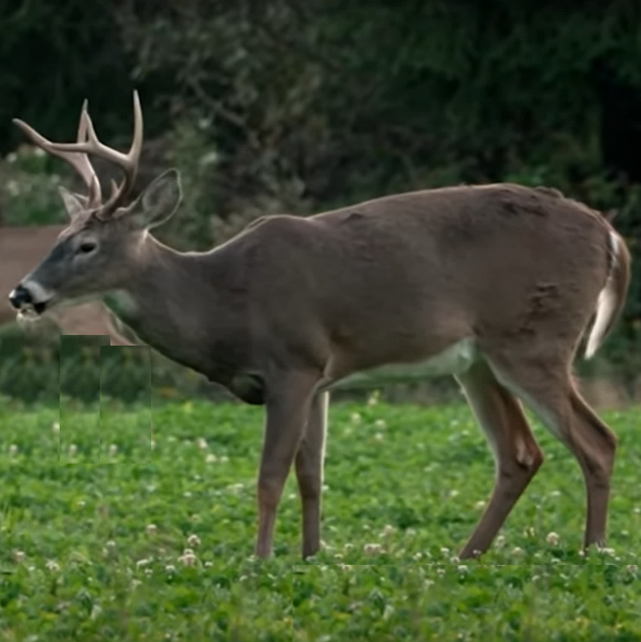
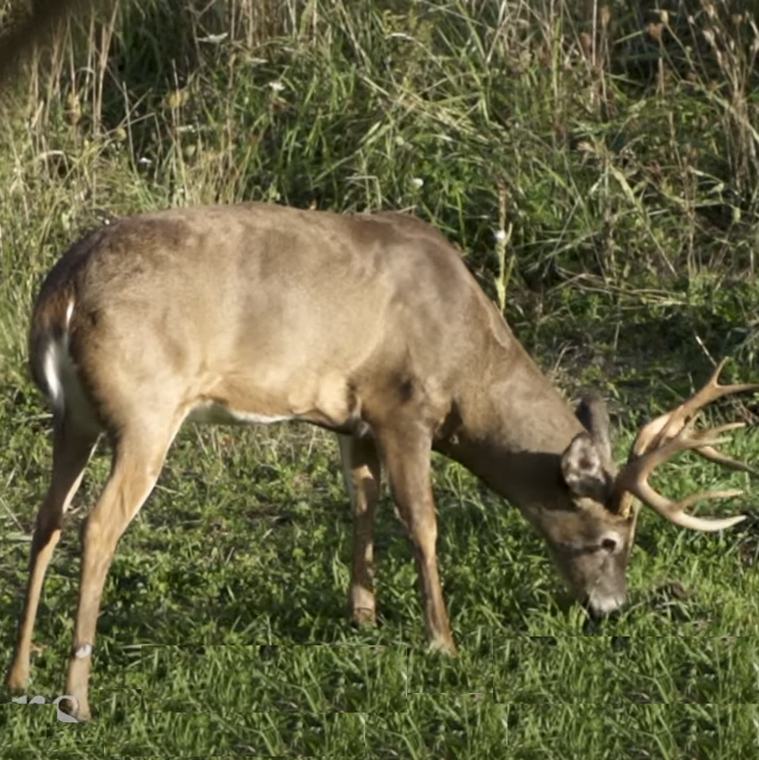
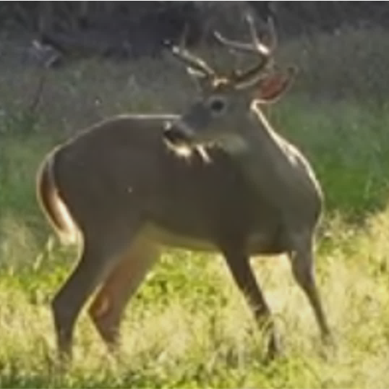
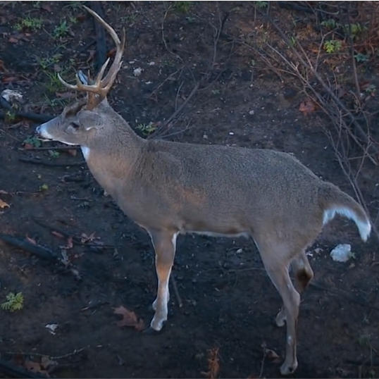
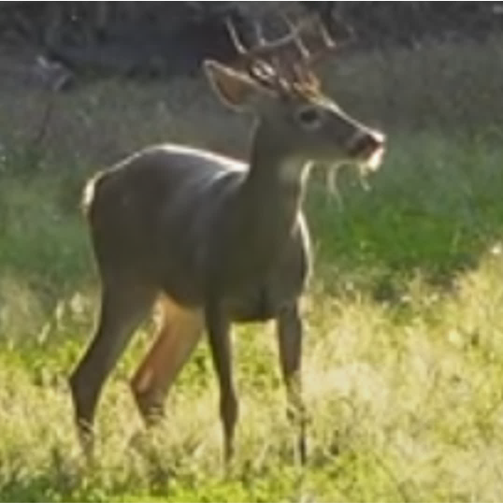
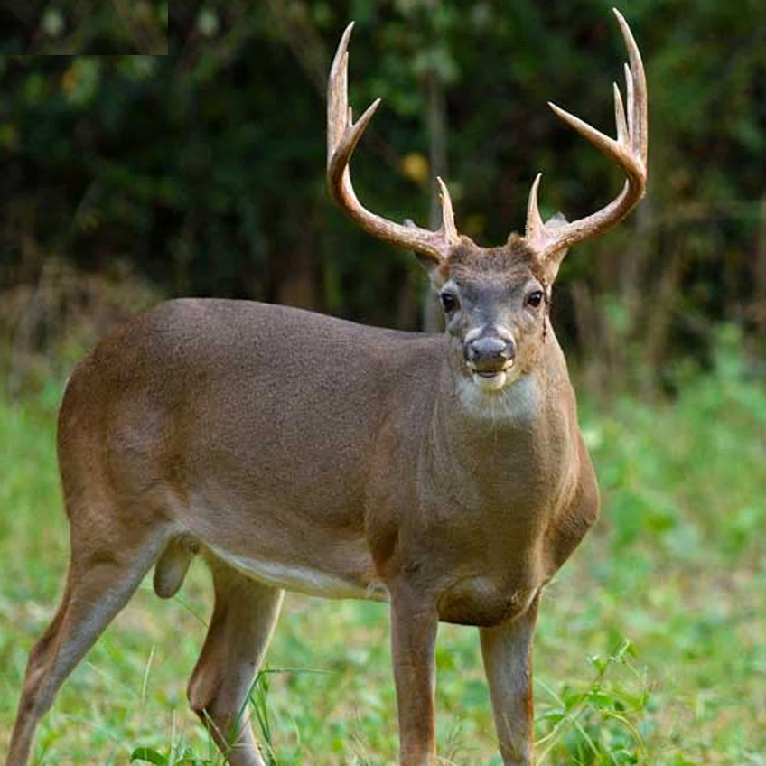
Data Preparation
Data collected through various sources
Resized images stored; info stored in metadata
Python collects, interpolates images
Model development
Store weights for inference
Data input by user via website
Data transferred to model via Railway
224
Predictions returned to user via website
224
Notes:
During model execution, Python collects the square-cropped images, interpolating each image to 224x224 (the image size expected by ResNet)
Examples of deer in different backgrounds, poses, ages, and locations are shown, illustrating the diversity of the dataset.

Slide 11
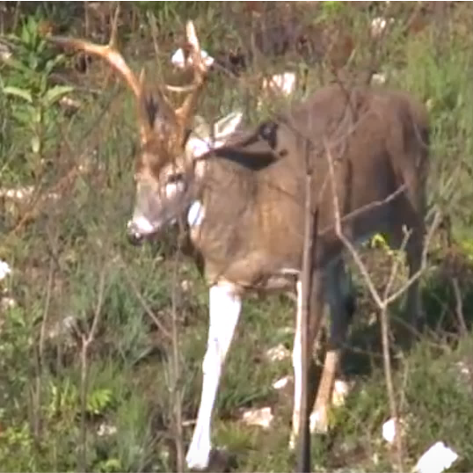
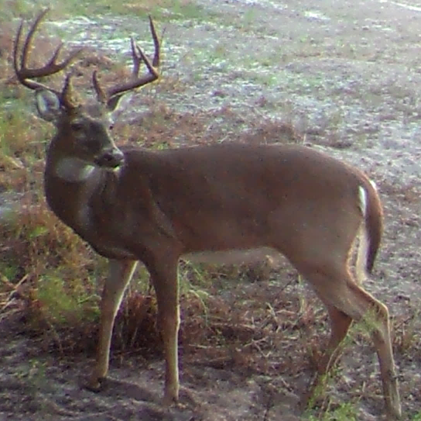
Model Training
Data collected through various sources
Resized images stored; info stored in metadata
Python collects, interpolates images
Model development
Train
Validation
Test
Store weights for inference
Ensemble
. . .
Fold 1
Aug.
RN 1
Evaluate
Data input by user via website
Fold 5
Aug.
RN 5
Data transferred to model via Railway
Tuned ensemble
Predictions returned to user via website
Notes:
During model execution, Python collects the square-cropped images, interpolating each image to 224x224 (the image size expected by ResNet)
Examples of deer in different backgrounds, poses, ages, and locations are shown, illustrating the diversity of the dataset.

Slide 12
Model Validation
Data collected through various sources
Resized images stored; info stored in metadata
Python collects, interpolates images
Model development
Train
Validation
Test
Store weights for inference
Data input by user via website
Data transferred to model via Railway
Tuned ensemble
Predictions returned to user via website
Inference
Error analysis
Notes:
During model execution, Python collects the square-cropped images, interpolating each image to 224x224 (the image size expected by ResNet)
Examples of deer in different backgrounds, poses, ages, and locations are shown, illustrating the diversity of the dataset.

Slide 13
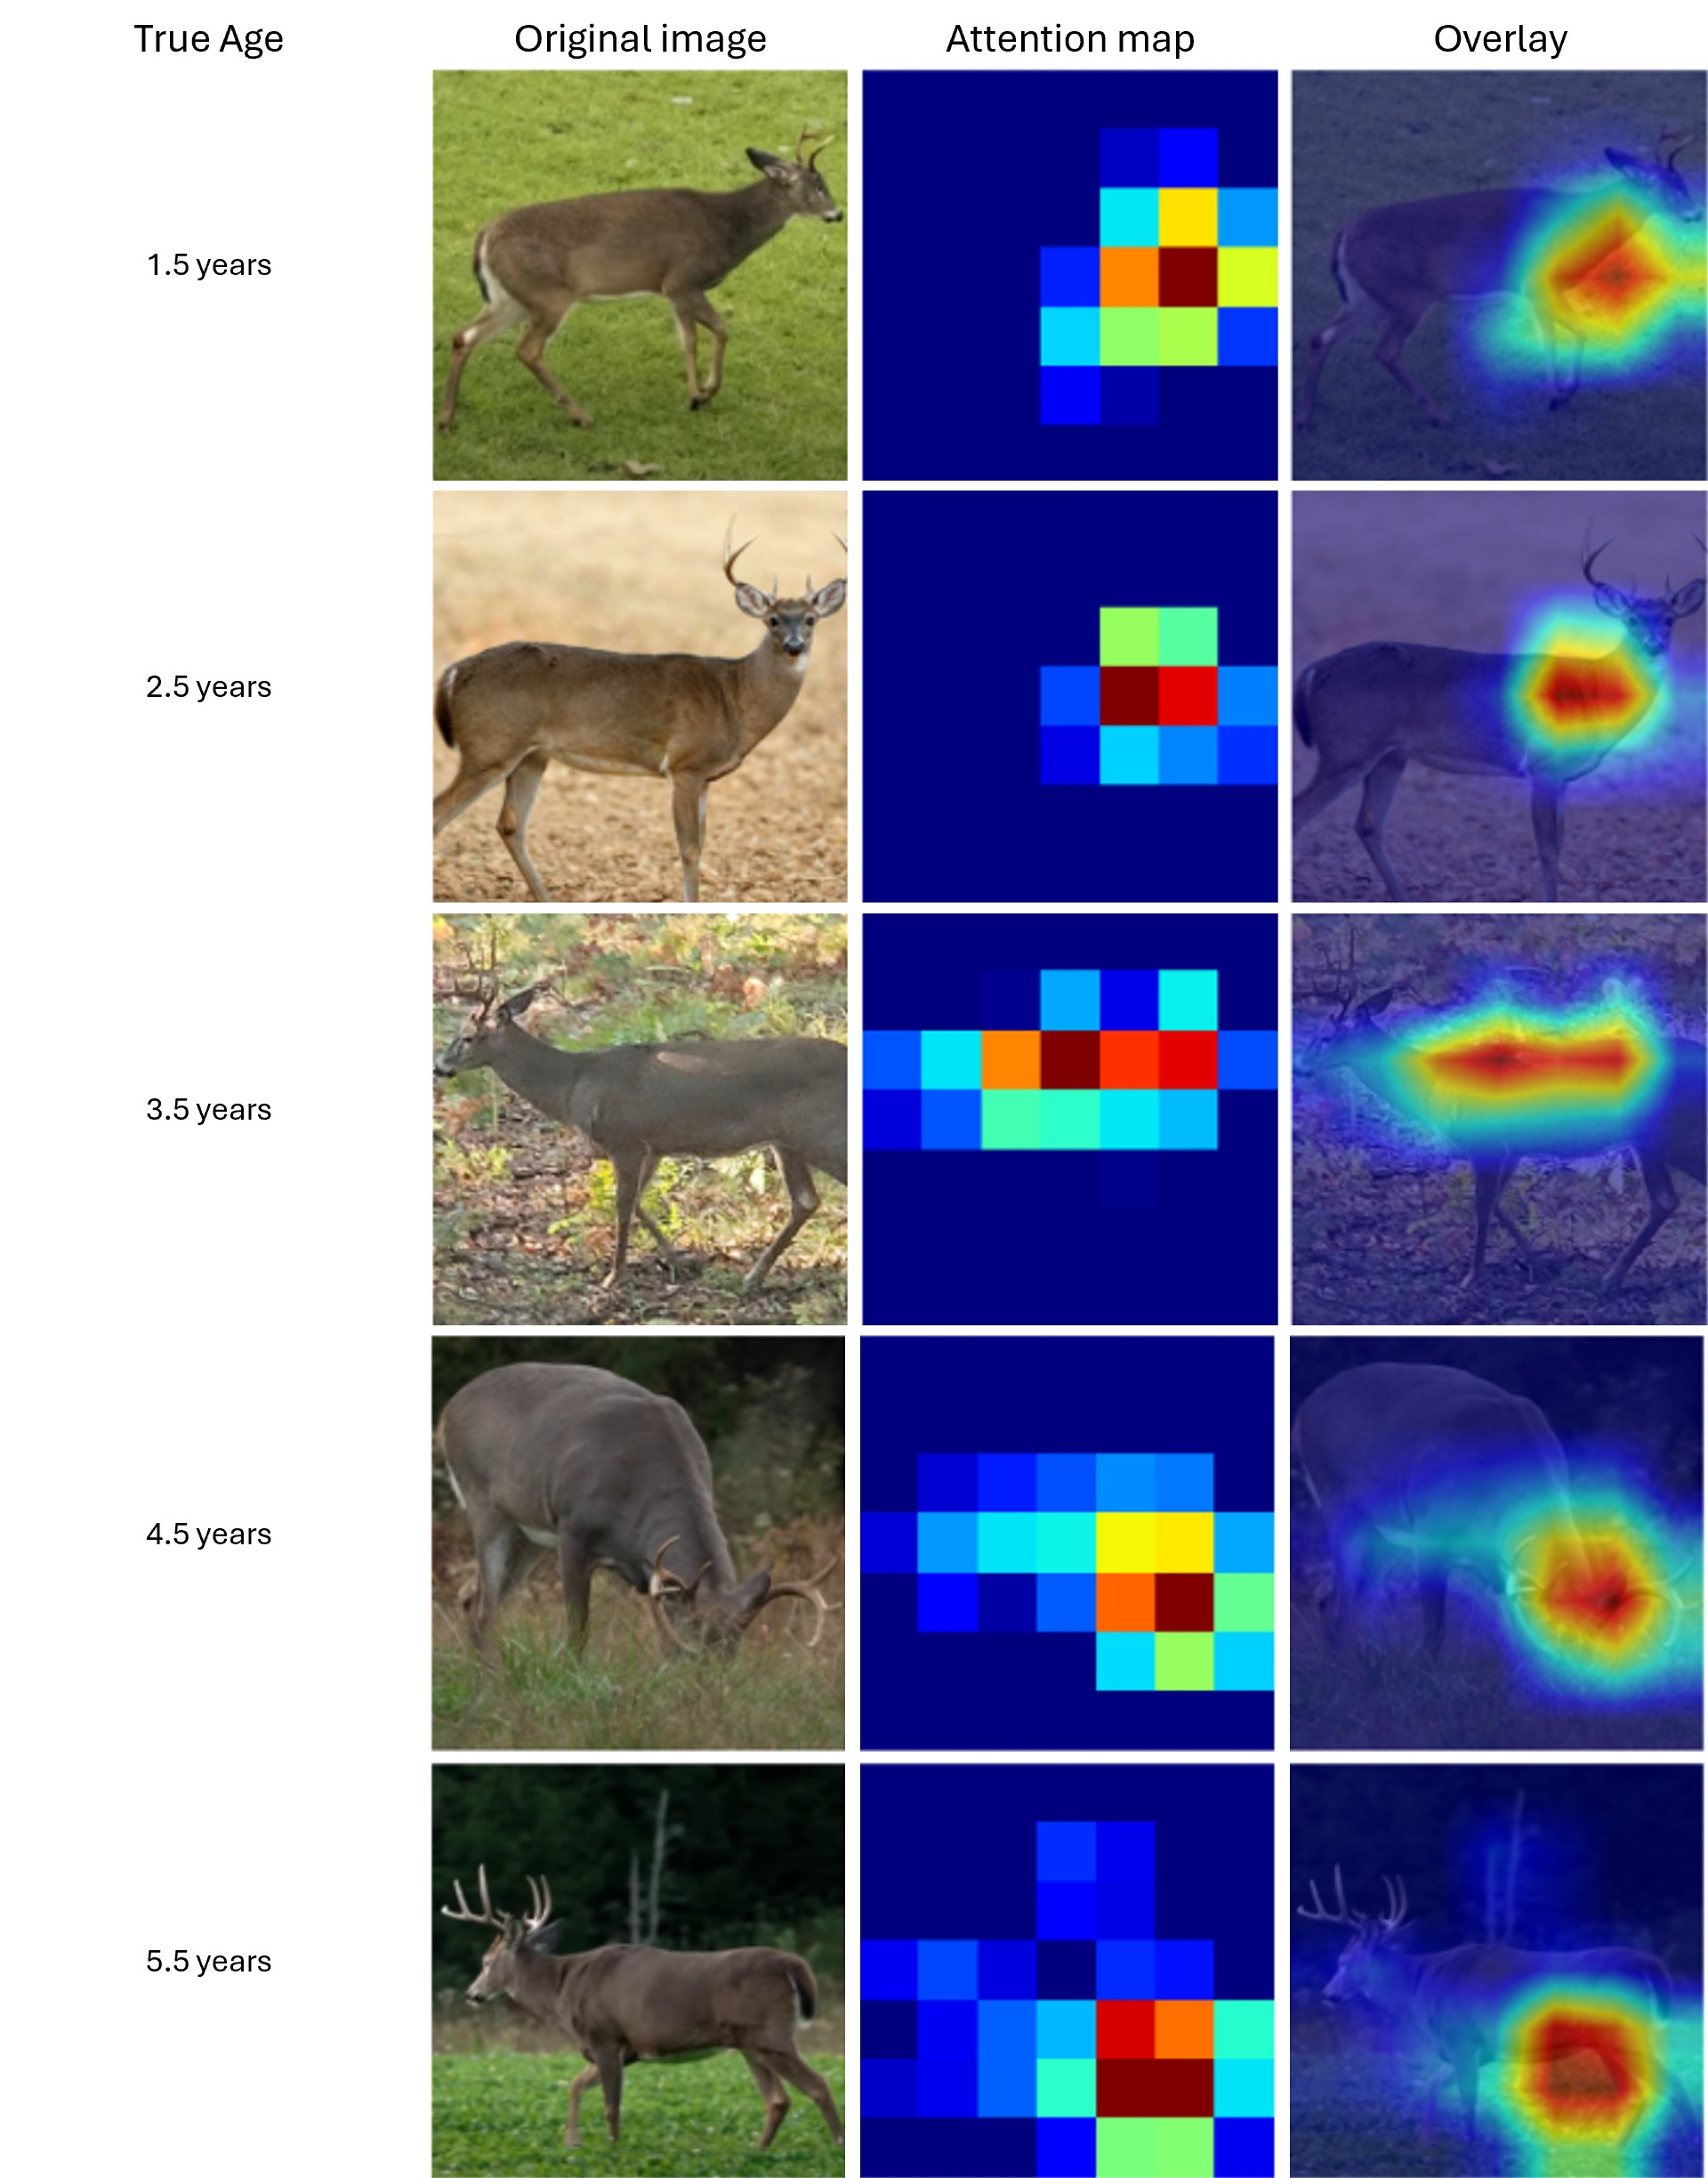
Model Inference
2.5 yrs old
87.3% confident
Tuned ensemble
Notes:
During model execution, Python collects the square-cropped images, interpolating each image to 224x224 (the image size expected by ResNet)
Examples of deer in different backgrounds, poses, ages, and locations are shown, illustrating the diversity of the dataset.

Slide 14
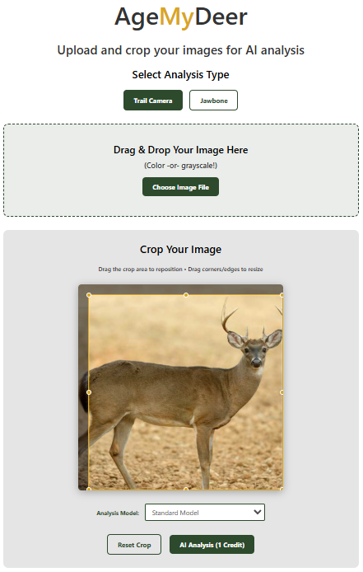
Model Deployment
Notes:
During model execution, Python collects the square-cropped images, interpolating each image to 224x224 (the image size expected by ResNet)
Examples of deer in different backgrounds, poses, ages, and locations are shown, illustrating the diversity of the dataset.

Slide 15
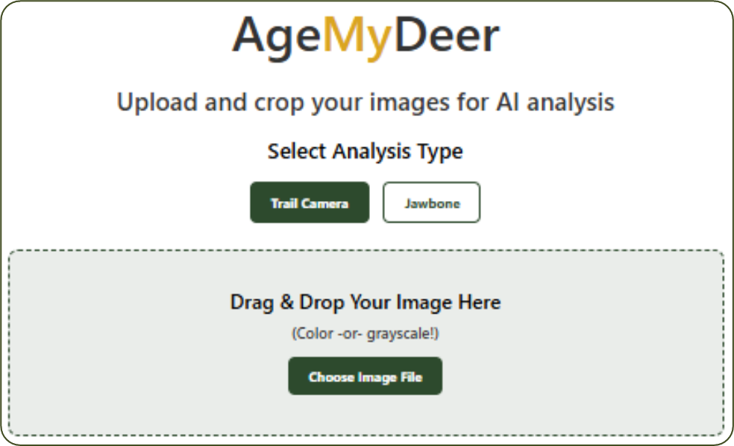
Model Deployment
Notes:
During model execution, Python collects the square-cropped images, interpolating each image to 224x224 (the image size expected by ResNet)
Examples of deer in different backgrounds, poses, ages, and locations are shown, illustrating the diversity of the dataset.

Slide 16
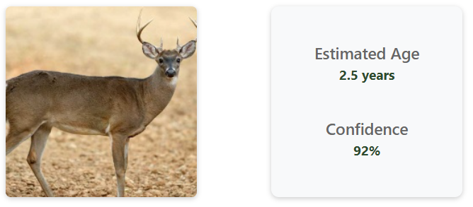
Model Deployment
Notes:
During model execution, Python collects the square-cropped images, interpolating each image to 224x224 (the image size expected by ResNet)
Examples of deer in different backgrounds, poses, ages, and locations are shown, illustrating the diversity of the dataset.

Slide 18
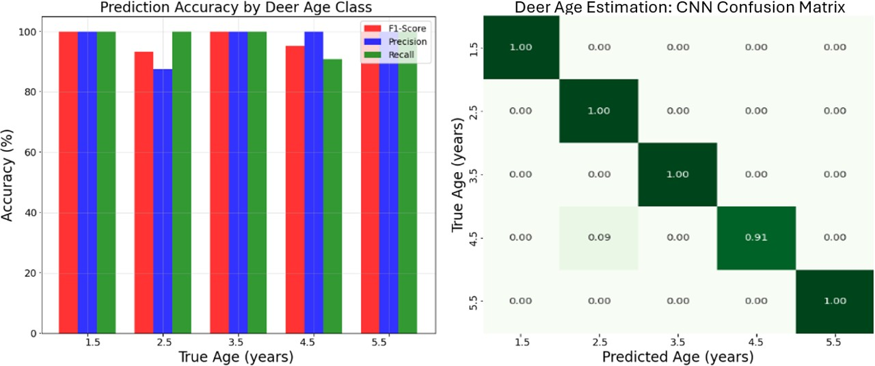
100
79.2%
19.0%
1.2%
0.0%
0.0%
80
79.2%
17.3%
63.1%
14.6%
3.3%
1.1%
60
63.1%
55.2%
0.9%
25.3%
55.2%
15.9%
2.4%
40
47.4%
48.3%
0.3%
3.9%
30.3%
47.4%
18.1%
20
0.3%
1.1%
9.5%
40.5%
48.3%
0
1.5
2.5
3.5
4.5
5.5+
Deer Age Estimation: CNN Confusion Matrix
100
79.2%
55.2%
48.3%
5.5
100%
0.0%
0.0%
0.0%
0.0%
63.1%
47.4%
79.2%
19.0%
1.2%
0.0%
0.0%
80
4.5
0.0%
100%
0.0%
0.0%
0.0%
17.3%
63.1%
14.6%
3.3%
1.1%
60
3.5
0.0%
0.0%
100%
0.0%
0.0%
0.9%
25.3%
55.2%
15.9%
2.4%
40
2.5
0.0%
9.0%
0.0%
91.0%
0.0%
0.3%
3.9%
30.3%
47.4%
18.1%
20
1.5
0.3%
1.1%
9.5%
40.5%
0.0%
0.0%
0.0%
0.0%
48.3%
100%
0
1.5
2.5
3.5
4.5
5.5+

Slide 19
Extra images

Slide 20
ResNet-18
Model 1
Fold 1
Model 1 TTA (Original + Flip) → Avg. Prediction
ResNet-18
Model 2
Fold 2
Model 2 TTA (Original + Flip) → Avg. Prediction
Original image
Input
224 x 224 x 3
Deer image
ResNet-18
Model 3
Fold 3
Model 3 TTA (Original + Flip) → Avg. Prediction
Ensemble Agg.
SoftMax average
Final Prediction
Flipped image
ResNet-18
Model 4
Fold 4
Model 4 TTA (Original + Flip) → Avg. Prediction
ResNet-18
Model 5
Fold 5
Model 5 TTA (Original + Flip) → Avg. Prediction

Slide 21
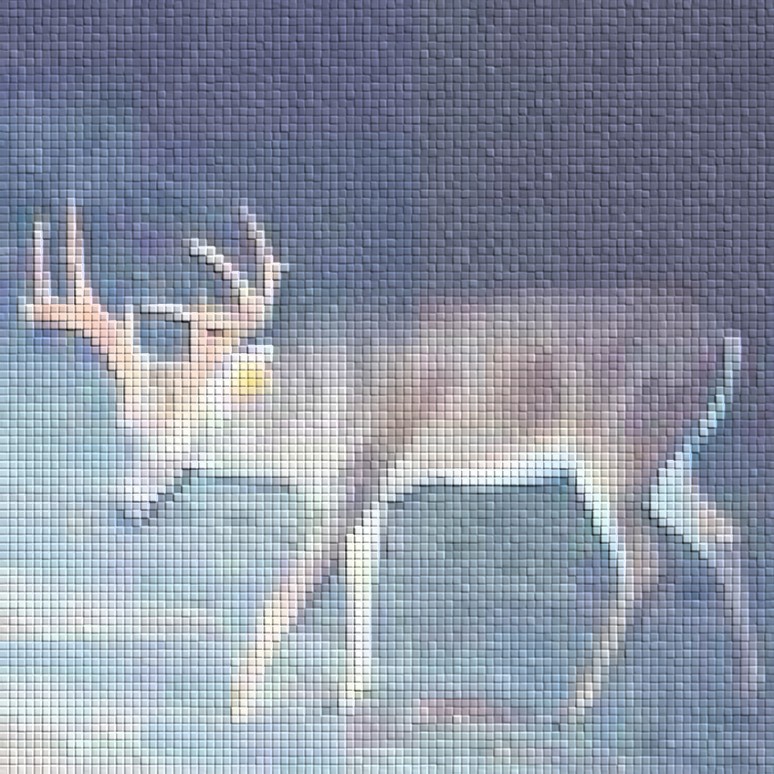
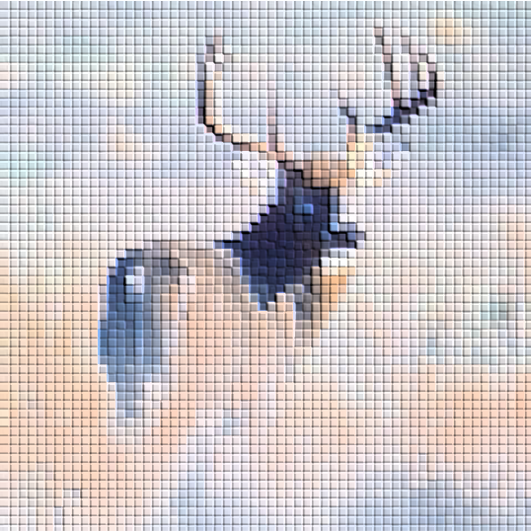
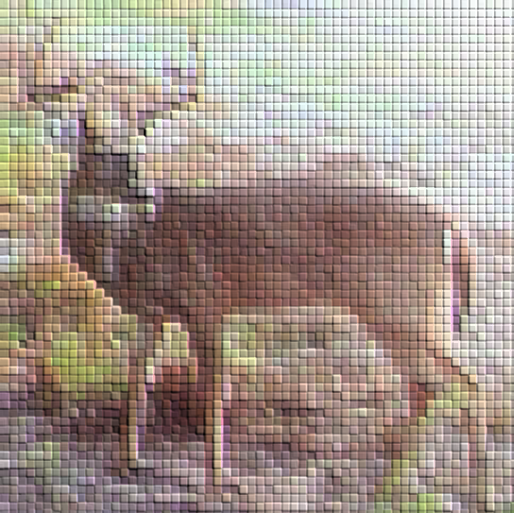
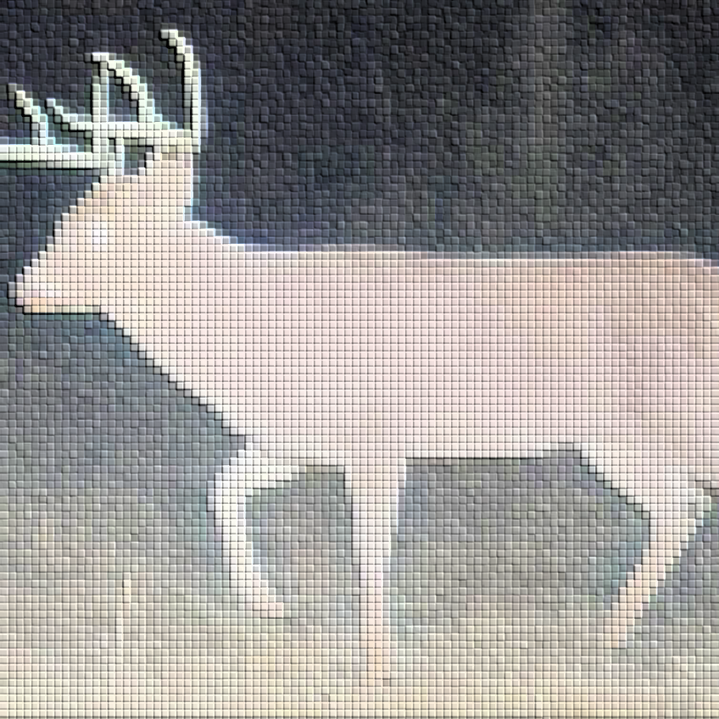
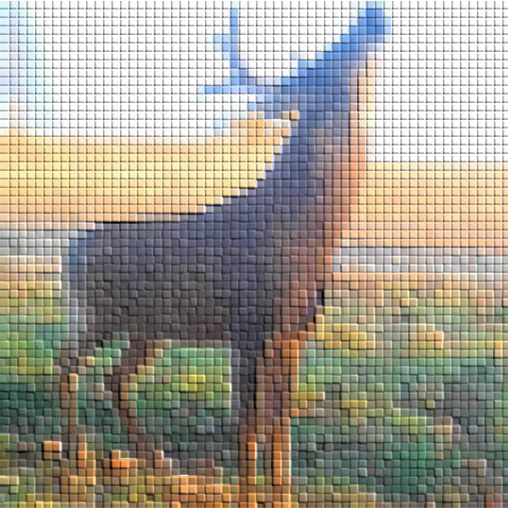
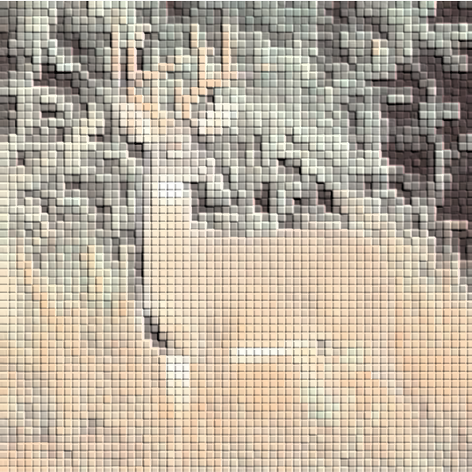
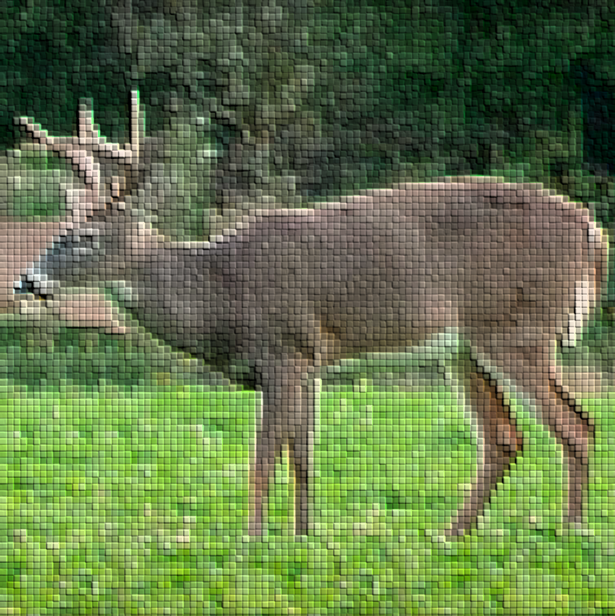
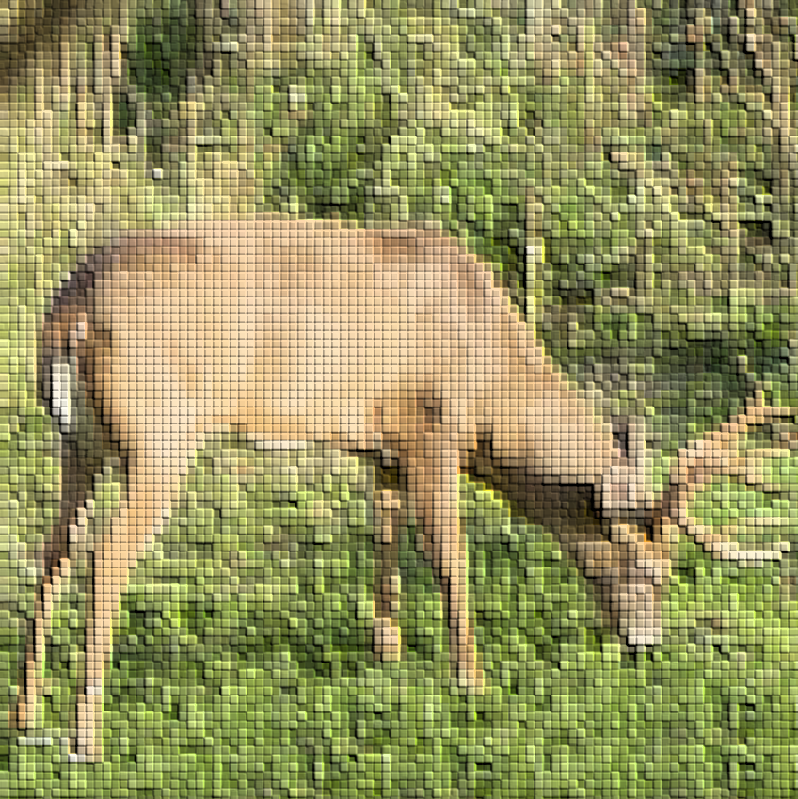
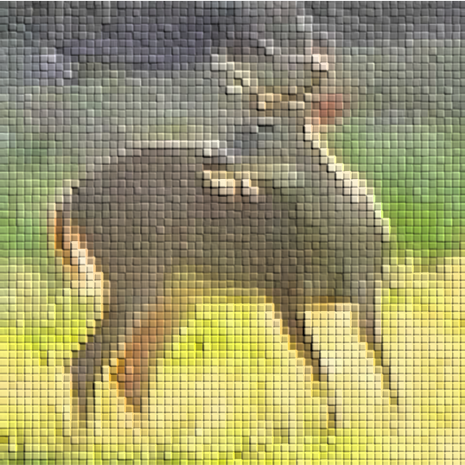
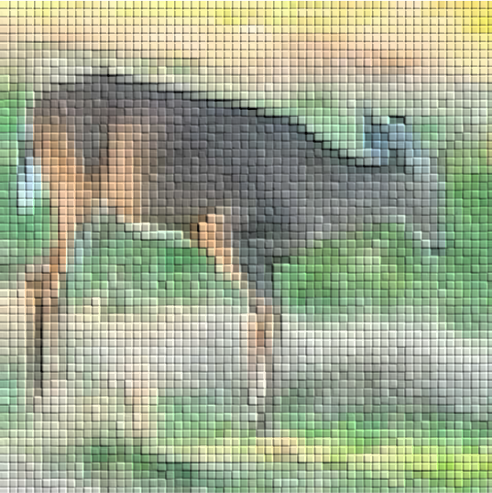
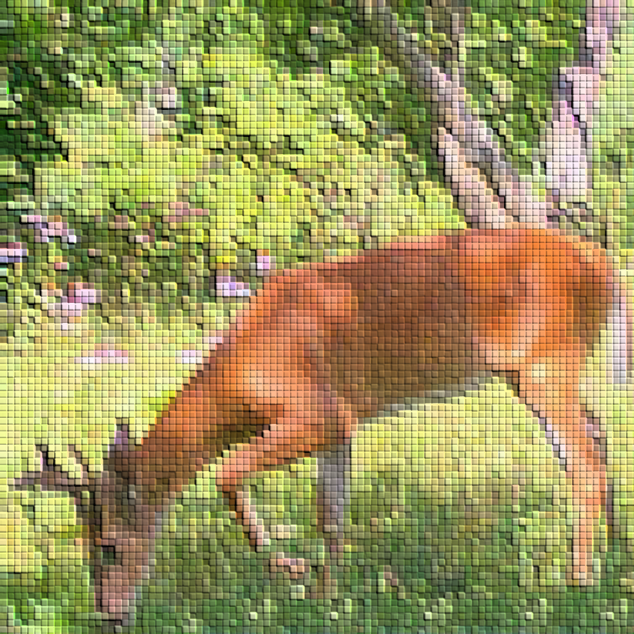
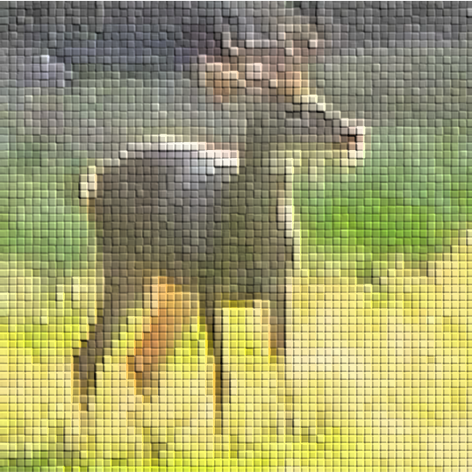
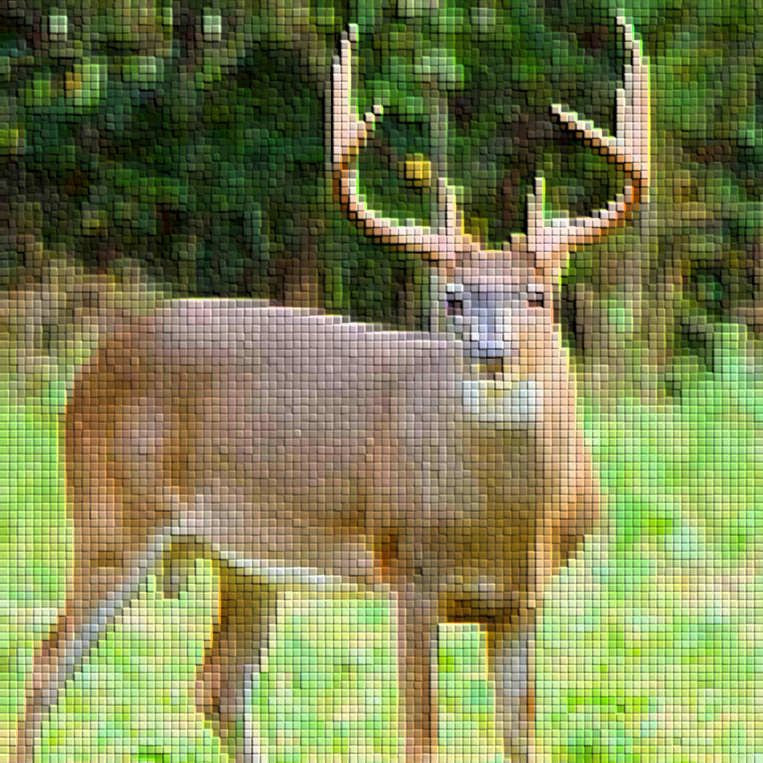
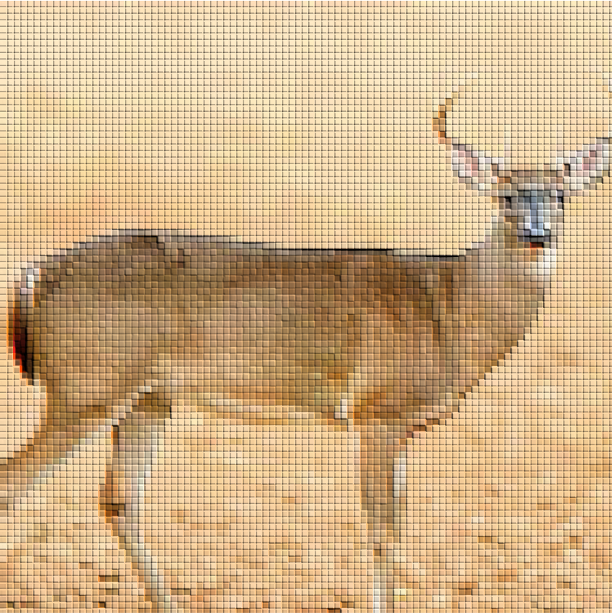
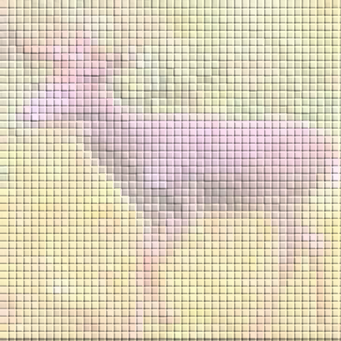
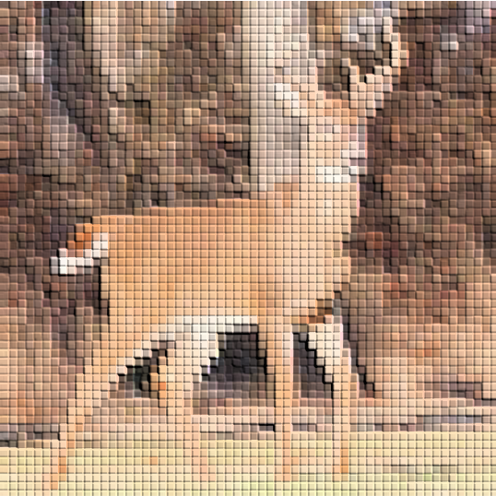
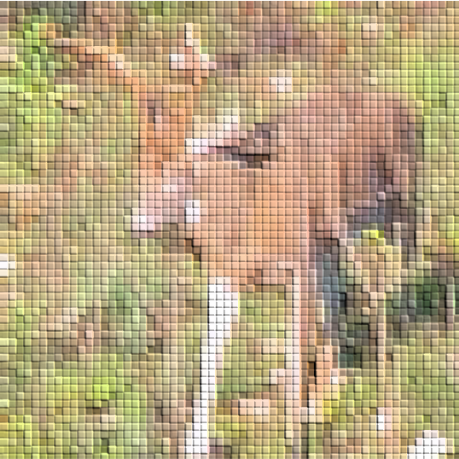
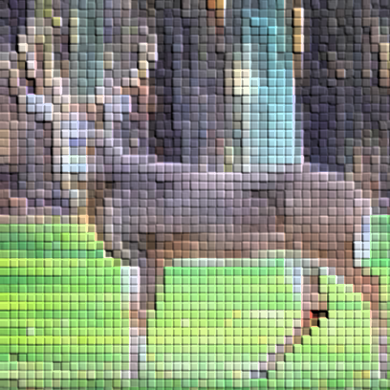
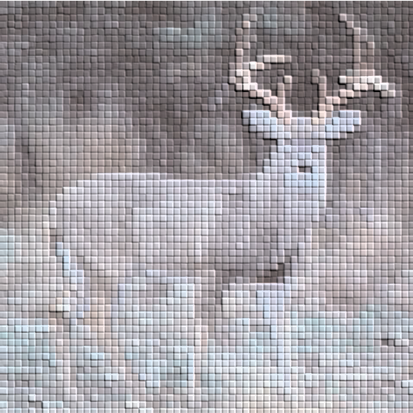

Slide 22
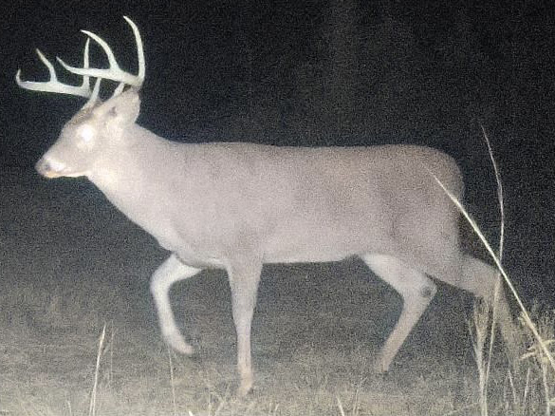
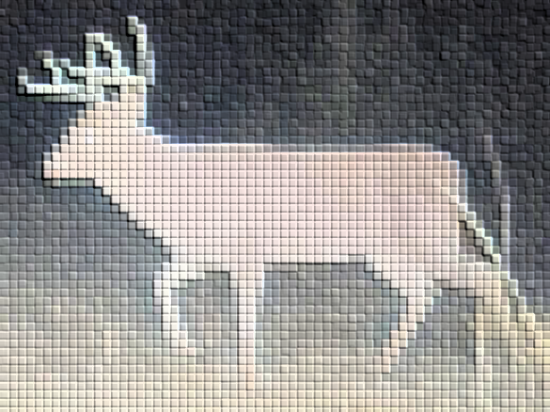
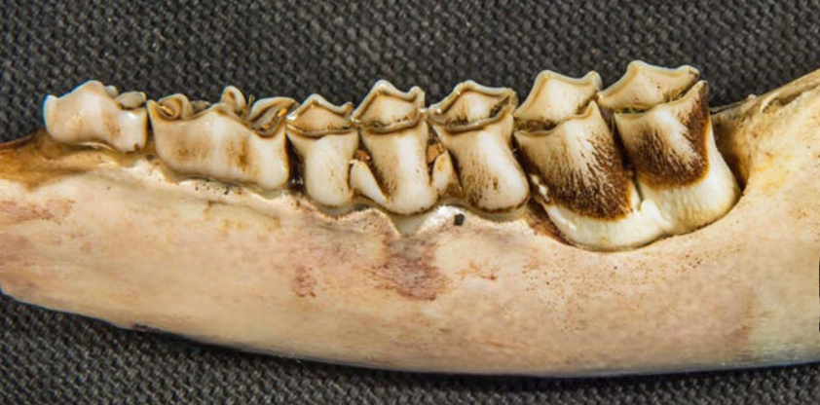
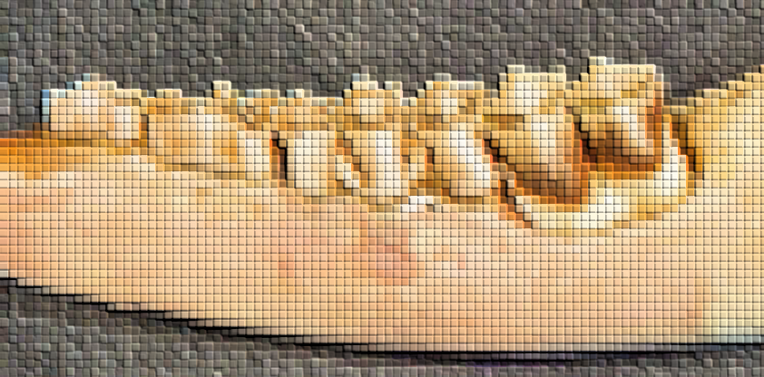
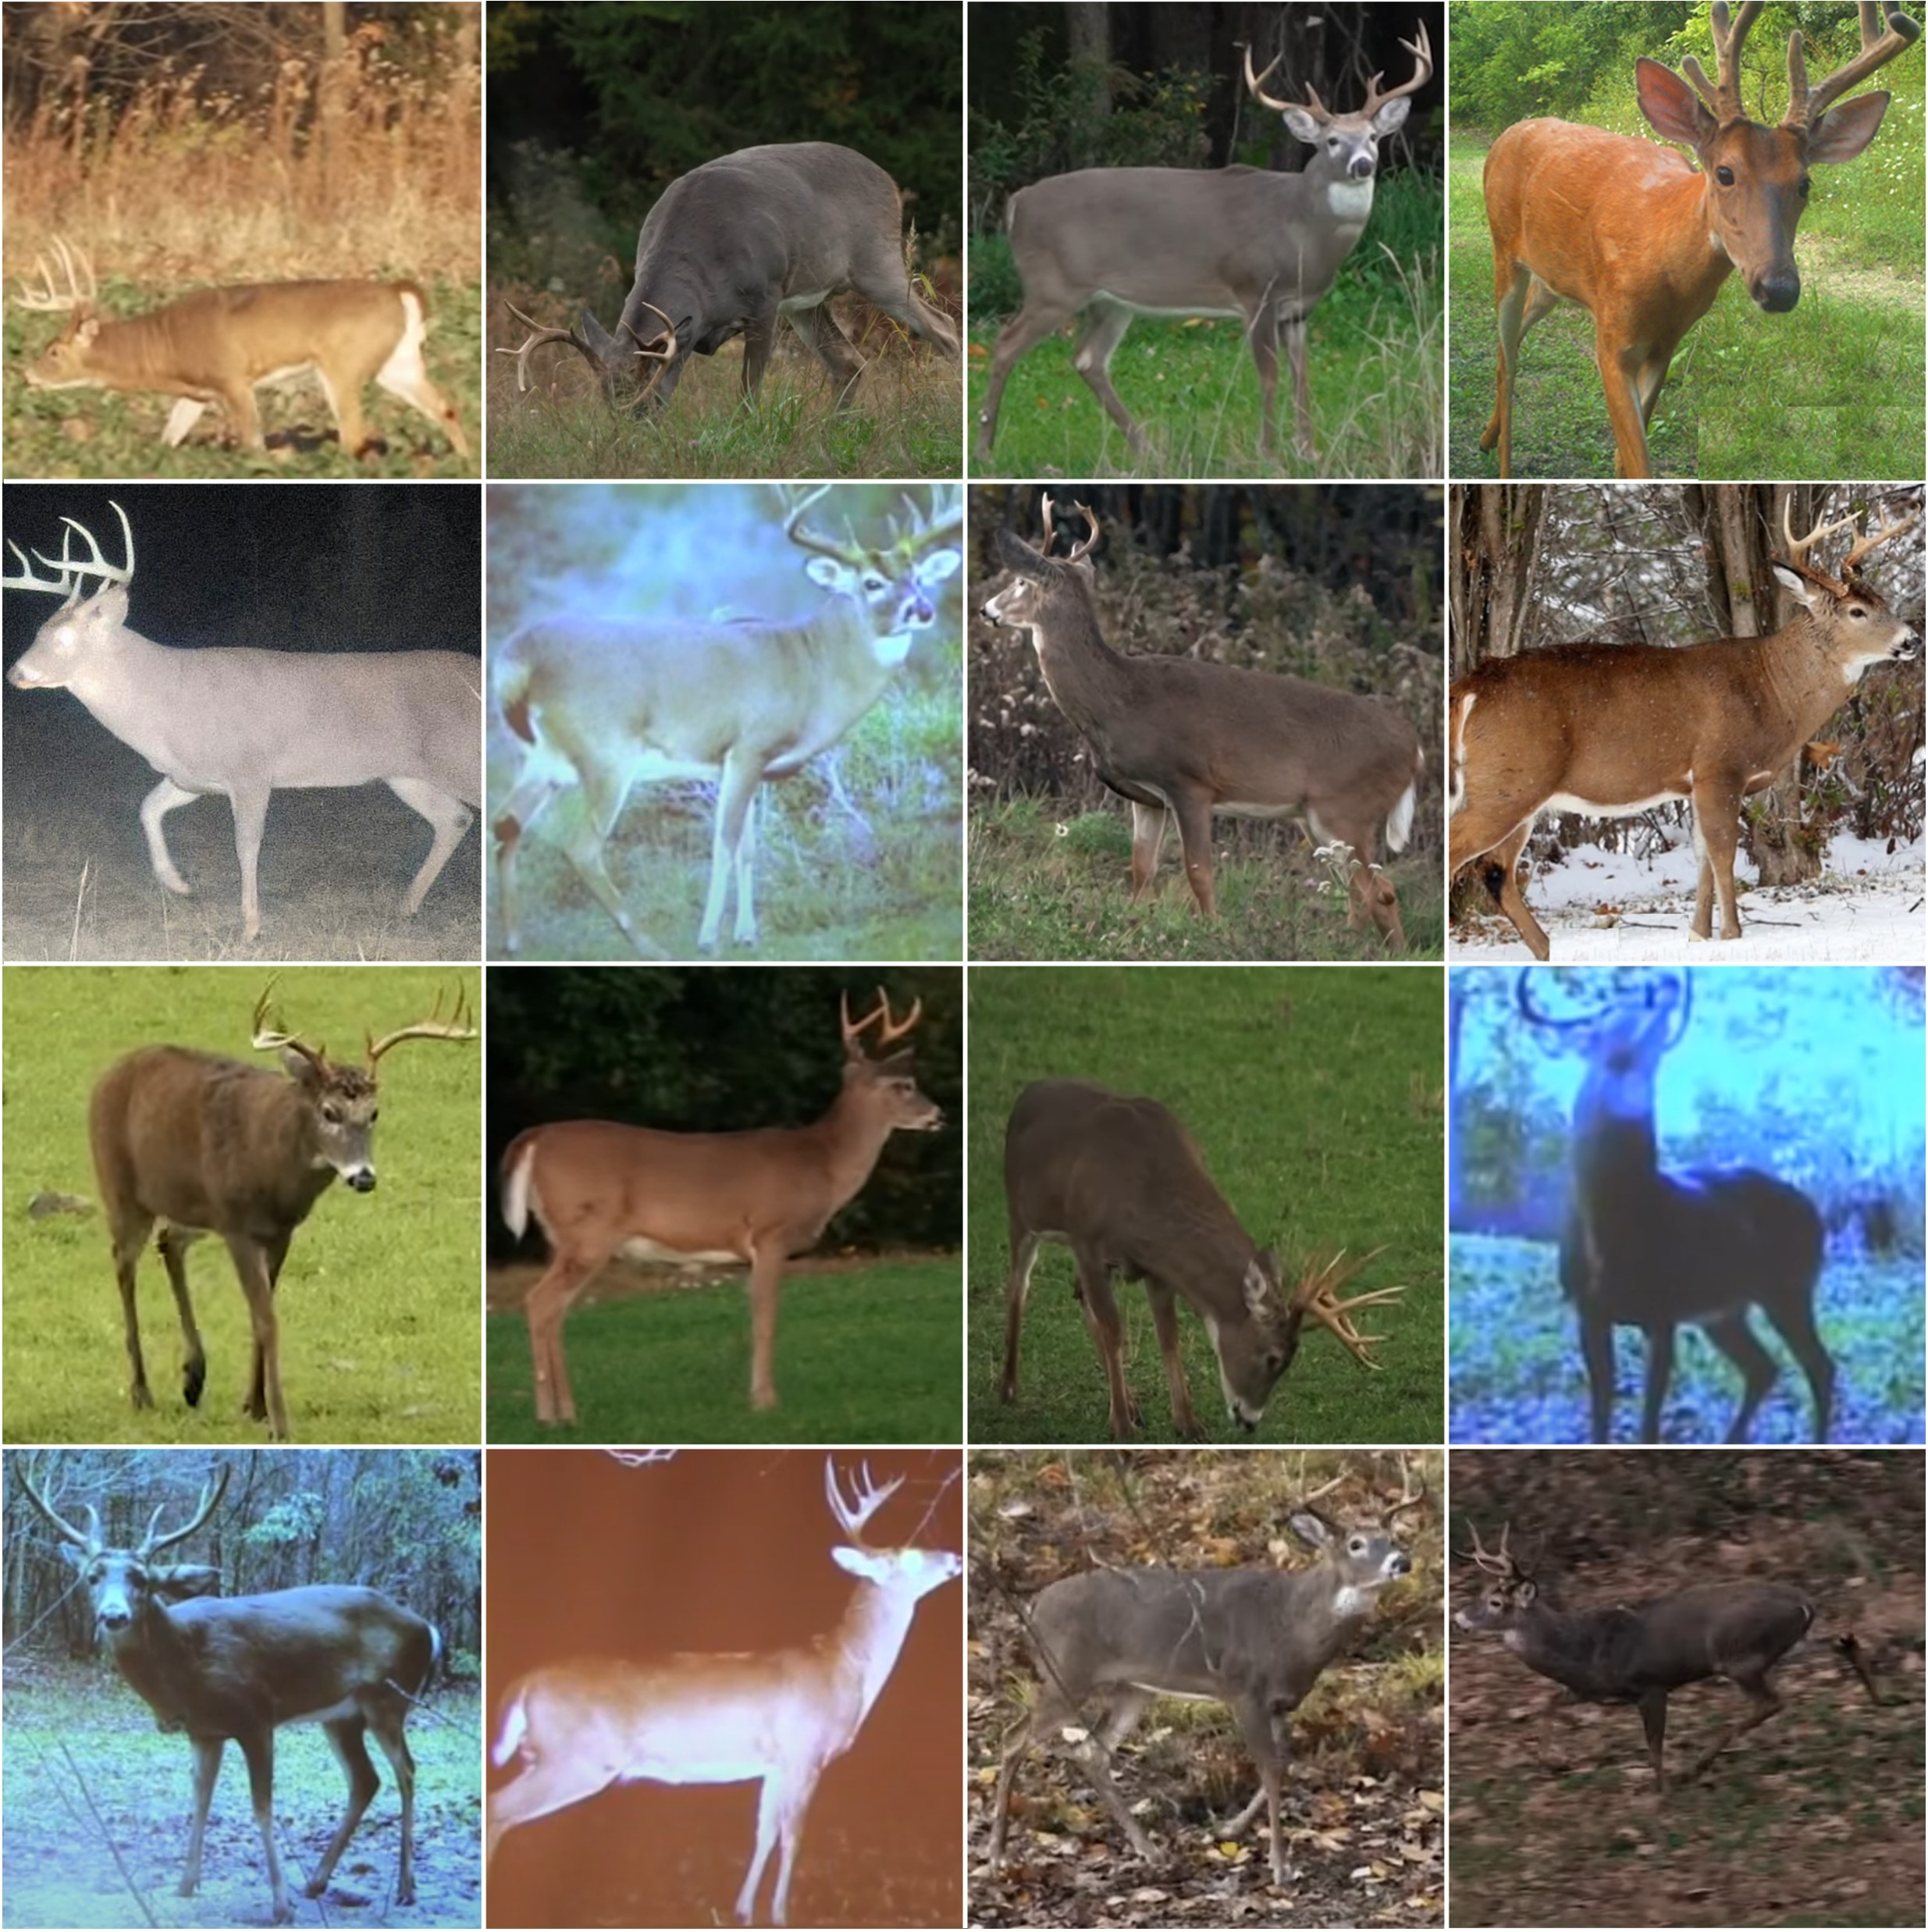
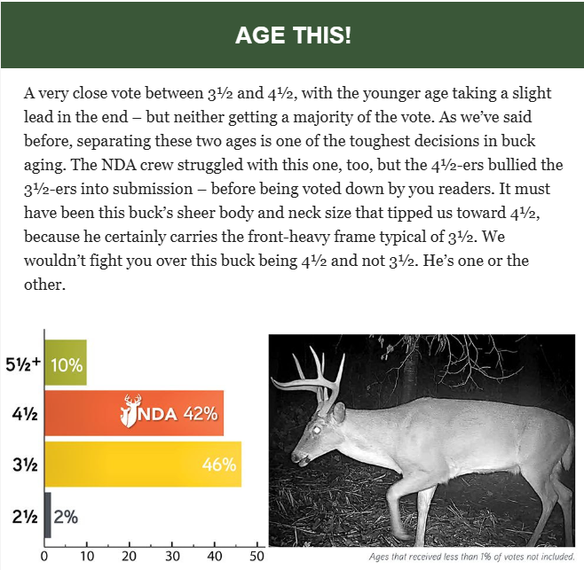



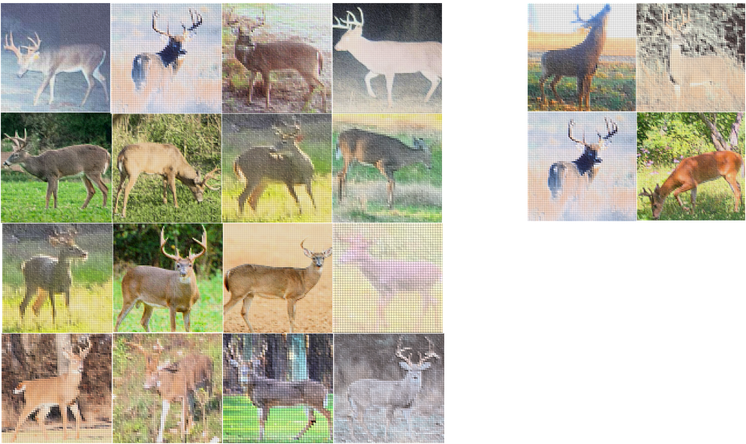
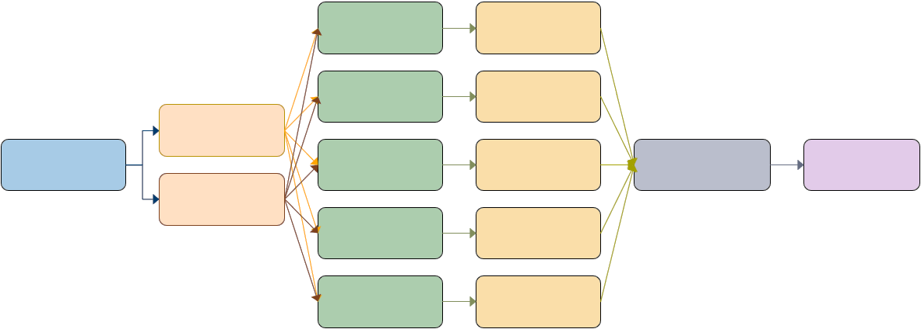
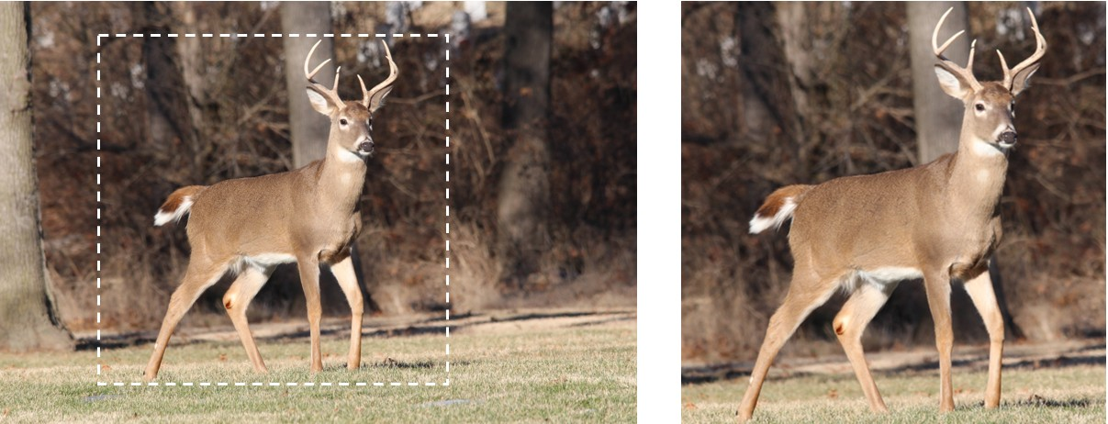
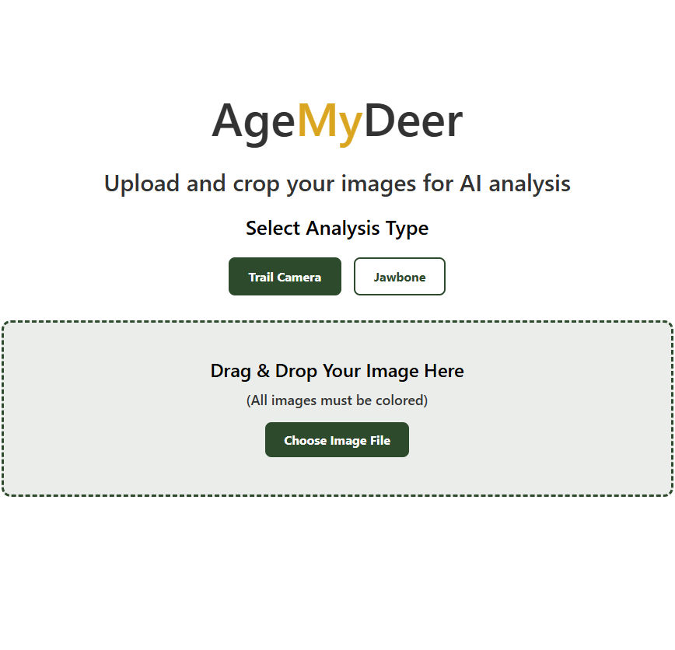








Data collected through various sources
Resized images stored; info stored in metadata
Python collects, interpolates images
Model development
Store weights for inference
Data input by user via website
Data transferred to model via Railway
Date | Model | Img size | Img type | Validation | Test | Metric | Filename
7/2/25 | Ensemble | 244 x 244 | Color | - | - | - | trailcam_ensemble
9/18/25 | EfficientNet-B5 | 512 x 512 | BW / Color | 80.4% | 78.4% | 0.63 | 251809_enb5
Predictions returned to user via website

